Slide 1
Risk Management
Application Security Testing

Slide 2
Project Risks
What can go wrong?
What is the likelihood?
What will the damage be?
What can we do about it?

Slide 3
Defining Risk
Definitions
  Risk is potential for realization of unwanted negative consequences of an event (Rowe William 1988)
  Risk is the measure of the probability of and severity of adverse effects (Lawrence 1976)
  Risk is the possibility of suffering loss, injury, disadvantage or destruction.(Webster 1981)
  Risk is the possibility of suffering loss (SEI)
Many definitions, no universally accepted definition
Common characteristics
  Uncertainty – An event may or may not happen
  Loss – an event has unwanted consequences or losses

Slide 4
Stating Risk
Two conditions
  A description of the current conditions that may lead to loss
  A description of the loss
“You Must Actively Attack a Project’s Risks, Otherwise They Will Actively Attack You.”- Grady Booch

Slide 5
Reactive Risk Management
  project team reacts to risks when they occur
  mitigation—plan for additional resources in anticipation of fire fighting
  fix on failure—resource are found and applied when the risk strikes
  crisis management—failure does not respond to applied resources and project is in jeopardy

Slide 6
Proactive Risk Management
formal risk analysis is performed
organization corrects the root causes of risk
  TQM concepts and statistical SQA
  examining risk sources that lie beyond the bounds of the software
  developing the skill to manage change

Slide 7
Risk Management Principles
Global perspective
Forward looking View
Open communication
Integrated management
Continuous process
Shared product vision
Working cooperatively to achieve common goals

Slide 8
Risk Management Paradigm
control
track
RISK
identify
plan
analyze

Slide 9
Building the Risk Table
Estimate the probability of occurrence
Estimate the impact on the project on a scale of 1 to 5, where
  1 = low impact on project success
  5 = catastrophic impact on project success
sort the table by probability and impact

Slide 10
Risk Mitigation, Monitoring, and Management
mitigation—how can we avoid the risk?
monitoring—what factors can we track that will enable us to determine if the risk is becoming more or less likely?
management—what contingency plans do we have if the risk becomes a reality?

Slide 11
Risk Due to Product Size
Attributes that affect risk:
• estimated size of the product in LOC or FP?
• estimated size of product in number of programs,
files, transactions?
• number of users of the product?
• size of database created or used by the product?
• number of projected changes to the requirements
for the product? before delivery? after delivery?

Slide 12
Risk Due to Business Impact
Attributes that affect risk:
• affect of this product on company revenue?
• visibility of this product by senior management?
• reasonableness of delivery deadline?
• number of customers who will use this product
• amount and quality of product documentation that
must be produced and delivered to the customer?
• governmental constraints
• costs associated with late delivery?
• costs associated with a defective product?

Slide 13
Risks Due to the Customer
Questions that must be answered:
• Have you worked with the customer in the past?
• Does the customer have a solid idea of requirements?
• Has the customer agreed to spend time with you?
• Is the customer willing to participate in reviews?
• Is the customer technically sophisticated?
• Does the customer understand the software
engineering process?

Slide 14
Risks Due to Process Maturity
Questions that must be answered:
• Have you established a common process framework?
• Is it followed by project teams?
• Do you have management support for
software engineering
• Do you have a proactive approach to SQA?
• Do you conduct formal technical reviews?
• Have document formats been established?

Slide 15
Technology Risks
Questions that must be answered:
• Is the technology new to your organization?
• Are new algorithms, I/O technology required?
• Is new or unproven hardware involved?
• Is a specialized user interface required?
• Are there significant performance constraints?
• Is there doubt the functionality requested is "do-able?"

Slide 16
Staff/People Risks
Questions that must be answered:
• Are the best people available?
• Does staff have the right skills?
• Are enough people available?
• Are staff committed for entire duration?
• Will some people work part time?
• Do staff have the right expectations?
• Have staff received necessary training?
• Will turnover among staff be low?

Slide 17
Recording Risk Information
Project: Embedded software for XYZ system
Risk type: schedule risk
Priority (1 low ... 5 critical): 4
Risk factor: Project completion will depend on tests which require
hardware component under development. Hardware component
delivery may be delayed
Probability: 60 %
Impact: Project completion will be delayed for each day that
hardware is unavailable for use in software testing
Monitoring approach:
Scheduled milestone reviews with hardware group
Contingency plan:
Modification of testing strategy to accommodate delay using
software simulation
Estimated resources: 6 additional person months beginning 7-1-96

Slide 18
Risk management
Risk management is concerned with identifying risks and drawing up plans to minimise their effect on a project
A risk is a probability that some adverse circumstance will occur
  Project risks affect schedule or resources
  Product risks affect the quality or performance of the software being developed
  Business risks affect the organisation developing or procuring the software

Slide 19
The risk management process (I)
Risk Assessment
Risk identification
  Identify project, product and business risks
  Historical database, Brainstorming, Checklists
Risk analysis
  Assess the likelihood and consequences of these risks (Probability and Impact)
Prioritise
Risk Control
Risk planning
  Draw up plans to avoid or minimise the effects of the risk, Reduce probability
Risk monitoring
  Monitor the risks throughout the project, Regular reviews, Status reporting
Resolution
  Track implementation, Review effectiveness, Re-assess risk

Slide 20
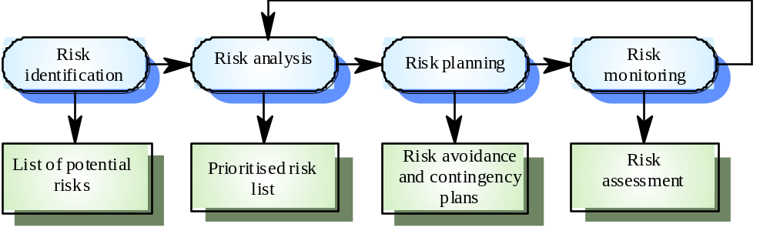
The risk management process (II)

Slide 21
Risk identification
Technology risks
People risks
Organisational risks
Tools risks
Requirements risks
Estimation risks

Slide 22
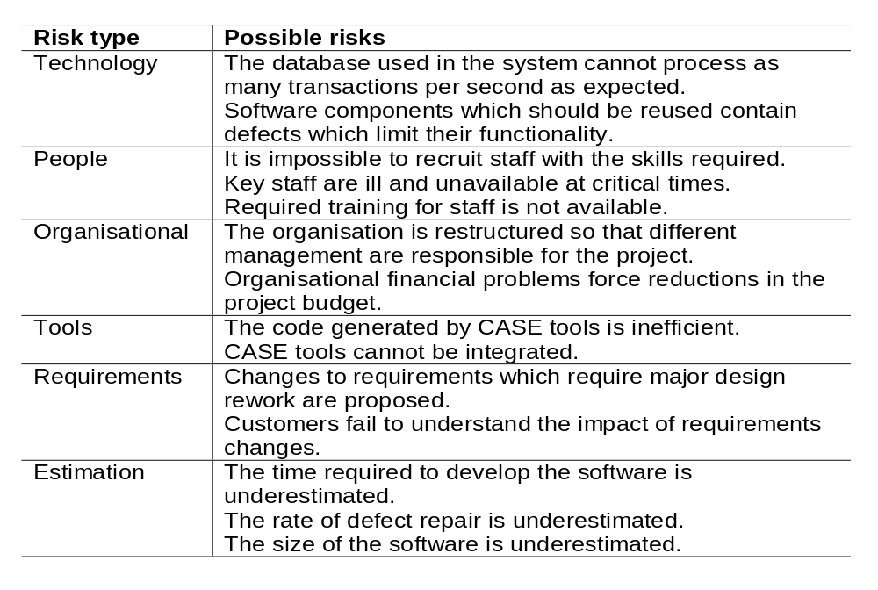
Risks and risk types

Slide 23
Risk analysis
Assess probability and seriousness of each risk
Probability may be very low, low, moderate, high or very high
Risk effects might be catastrophic, serious, tolerable or insignificant

Slide 24
Risk planning
Consider each risk and develop a strategy to manage it
Avoidance strategies
  Probability that the risk will arise is reduced
Minimisation strategies
  Impact of the risk on the project or product is reduced
Contingency plans
  If the risk arises, contingency plans are plans to deal with the risk

Slide 25
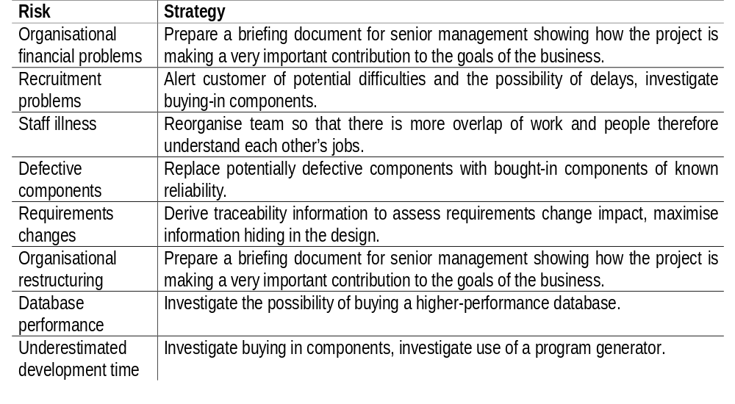
Risk management strategies

Slide 26
Risk monitoring
Assess each identified risks regularly to decide whether or not it is becoming less or more probable
Also assess whether the effects of the risk have changed
Each key risk should be discussed at management progress meetings

Slide 27
Good Practices
Acknowledgement that risks are inevitable
Communicate risks openly
Reward people who prevent crisis
Don’t try to manage too many risks at a time
Write down risks
Integrate risk management into project management
Don’t emphasize too much on quantification at the start
Don’t look at cost benefit analysis of implementing risk management
Remember that risk plan may introduce new risks or increase cost
Risk evasion should be the ‘last’ resort and should be done ‘consciously’
Use a risk database at an organization level
Don’t focus only on easy risks
Categorize risks

Slide 28
Application Security Testing

Slide 29
Security TESTING
Attempts to verify that protection mechanisms built in to a system will in fact protect it from improper logins.
The tester plays the role of an individual who desires to hack the system.

Slide 30
Why Web application security is important
Reduce cost of recovery and fixes
  Computer security attacks costs as much as $10 billion a year
Ensure Customer Trust
  Trust is a key component to customer adoption and retention
Ensure Website Adoption
  Customers are still not adopting websites as a preferred channel for doing business
Maintain Competitive Advantage
  Many organizations are using trust as a key
  Competitive advantage and are leveraging customer fears to proactively implement
  Security and privacy programs to ease the uncertainty.

Slide 31
Seven Main types of Security Testing
Vulnerability Scanning
Security Scanning
Penetration Testing
Risk Assessment
Security Auditing
Ethical Hacking
Posture Assessment & Security Testing

Slide 32
Seven Main types of Security Testing
Vulnerability Scanning is using automated software to scan one or more systems against known vulnerability signatures.
Security Scanning is a Vulnerability Scan plus Manual verification. The Security Analyst will then identify network weaknesses and perform a customized professional analysis.
Penetration Testing takes a snapshot of the security on one machine, the “trophy”. The Tester will attempt to gain access to the trophy and prove his access, usually, by saving a file on the machine. It is a controlled and coordinated test with the client to ensure that no laws are broken during the test.`

Slide 33
Seven Main types of Security Testing
Risk Assessment involves a security analysis of interviews compiled with research of business, legal, and industry justifications.
Security Auditing involves hands on internal inspection of Operating Systems and Applications, often via line-by-line inspection of the code.
Ethical Hacking is basically a number of Penetration Tests on a number of systems on a network segment.
Posture Assessment and Security Testing combine Security Scanning, Ethical Hacking and Risk Assessments to show an overall Security Posture of the organization.

Slide 34
How Hackers Get In
Browser-based attacks use flaws in the Web-based application code. Software most vulnerable to these types of attacks includes:
  User interface code -- provides the look and feel of the site
  Web server -- supports the physical communication between the user’s browser and the web applications
  Front-end applications-- interfaces directly with the user interface code, and backend systems

Slide 35
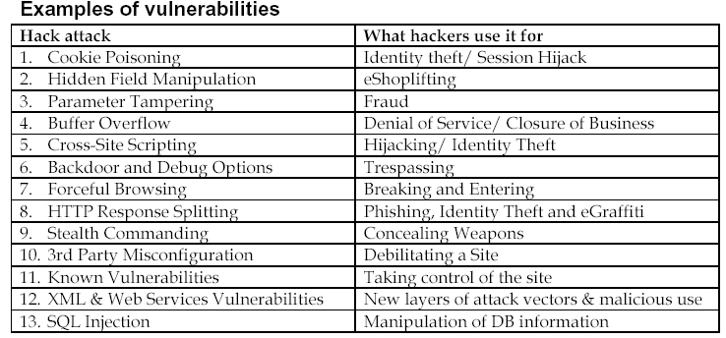
Examples of Vulnerabilities
Hack Attack
What hackers use it for
1. Cookie Poisoning
Identify theft/ Session Hijack
2. Hidden Field Manipulation
eShoplifting
3. Parameter Tampering
Fraud
4. Buffer Overflow
Denial of Service
5. Cross Site Scripting
Hijacking/ Identify Theft
6. Backdoor and Debug Option
Trespassing
7. Forceful Browsing
Breaking and Entering
8. HTTP Response Spitting
Identity
9. Stealth Commanding
Concealing Weapons
10. 3rd Party Misconfiguration
Debilitating a Site
11. Known Vulnerabilities
Taking control of the site
12. XML,Web Services Vulnerabilities
New layers of attack vendors
13. SQL Injection
Manipulation of DB information

Slide 36
Security Threats
Input Validation
Access Control
Broken Account and Session Management
Cross-site scripting flaws
Buffer overflow
Command line injection
Error handling problems
Insecure use of cryptography
Web and application server mis-configuration
Database testing
Privilege Elevation
Identify Spoofing

Slide 37
Security Threat One - Input validation
Unfiltered malicious inputs are the root cause of buffer overruns, cross-site scripting attacks, SQL injection attacks, and more. Attackers can tamper with any part of an HTTP request, including the URL, query string, headers, cookies, form fields, and hidden files. The baseline is "not trust user input" and "not trust client side process results".
• Attacker can easily change any part of the HTTP request before submitting
o URL
o Cookies
o Form fields
o Hidden fields
o Headers
• Encoding is not encrypting
• Inputs must be validated on the server (not just the client)
Countermeasures
• Application firewalls
• Code reviews (check variable against list of allowed values, not vice-versa)

Slide 38
Security Threat Two - Access Control
Access control is how an application grants access to content and functions, to some users and not others. A web application's access control model is closely tied to the content and functions that the site provides.
If access control rules are implemented in various locations all over the code, with a user falling into a member of groups or roles with different abilities or privileges, access control flaws are very likely to happen.
• Usually inconsistently defined/applied
• Examples
  o Insecure session IDs or keys and Client-side caching
  o Forced browsing past access control checks
  o Path traversal
  o File permissions – may allow access to config/password files

Slide 39
Security Threat Three - Broken Account and Session Management
If the application use the specification approved "user authentication infrastructures", then password change control, password strength, password storage, protecting credentials in transit, session ID protection, and trust relationship, are all taken care for you.
Weak authentication
  Password-only
  Easily estimable usernames (Admin., etc.)
  Unencrypted secrets are also insecure
How to break in
  Guess password
  Reset password
  Have application email you new password
  Sniff password
Backend authentication
  How database passwords are stored
  Trust relationships between hosts (IP address can be spoofed, etc.)

Slide 40
Security Threat Three - Broken Account and Session Management (contd.)
Start a session and login. Then leave the window open. Come back the second day, continue with a client side request. If you aren't prompt for login again, you need to submit a defect on no session timeout. This has to be test manually, no vulnerability scan tool for this.
Logs out from your application after doing some work the app. Then click on the back button of the browser, (need to click it several times to trigger this).
Login your web app, select everything from the website and copy and paste to outlook new email and send out to another email address. The other person who receives the email will be able to access all the app's links. Can even submit a request on behalf of the login person! It could be caused with an app that is using session ID information stored within fields of a form.

Slide 41
Security Threat Four - Cross-Site Scripting (XSS) Flaws
Cross-Site Scripting (XSS) attacks require the execution of Client-Side Languages (JavaScript, Java, VBScript, ActiveX, Flash, etc.).
XSS occurs when an attacker uses a web application to send malicious code to a different end user.
It involves disguising a script as a URL variable within a URL from a legitimate site, and tricking a user into clicking on that URL, perhaps by sending it in an official looking e-mail or using some other approach. If the site does not check URL variables, the script will then execute in the user's browser. While this does not attack the website directly, it can be used to run arbitrary code in a user's browser, collect userids and passwords, or anything else that a script can be used to do.

Slide 42
Security Threat Four - Cross-Site Scripting (XSS) Flaws (contd.)
Common sources of these kinds of attacks are web mail applications and web-based bulletin boards, but in some cases even web servers are also directly affected.
Attacker uses a trust application/ company to send malicious code to end-user
Attacker can “hide” the malicious code
  Unicode encoding
2 types of attacks
  Stored
  Reflected
Wide-spread problem!
Countermeasure: input validation
  Positive
  Negative: “< > ( ) # &”
  Don’t forget these: “&lt &gt &#40 &#41 &#35 &#38”

Slide 43
Security Threat Five - Buffer Overflow
A buffer overflow occurs when a program or process tries to store more data in a buffer (temporary data storage area) than it was intended to hold. Since buffers are created to contain a finite amount of data, the extra information - which has to go somewhere - can overflow into adjacent buffers, corrupting or overwriting the valid data held in them.
In buffer overflow attacks, the extra data may contain codes designed to trigger specific actions, in effect sending new instructions to the attacked computer that could, for example, damage the user's files, change data, or disclose confidential information. Buffer overflow attacks are said to have arisen because the C programming language supplied the framework, and poor programming practices supplied the vulnerability.
Countermeasures
  Keep up with bug reports
  Code reviews
  Use Java

Slide 44
Security Threat Six - Command injection flaws
Majority of programming languages have system commands to aide their functionality. When user input is not adequately checked, it is possible to executing operating system commands.
To test this vulnerability, you should test the input with all the OS commands that the server box is set up to support.
Allows attacker to relay malicious code in form variables or URL
  System commands
  SQL
  Interpreted code (Perl, Python, etc.)
Many applications use calls to external programs
  Sendmail
Examples
  Path traversal: “../”
  Add more commands: “; rm –r *”
  SQL injection
Countermeasures
  Taint all input
  Avoid system calls (use libraries instead)
  Run application with limited privileges

Slide 45
Security Threat Seven - Error Handling Problems
You should file a defect whenever you see a database error message is sent to an end user. Without a database error message, the application could still be vulnerable to blind sql attack, but the difficult level is much harder.
You should file a defect whenever application gives information reflects clues on potential flaws in the site. For example, a stack trace.
File a defect when you see inconsistencies in messages reveal important clues on how a site works, and what information is present under the covers.
Examples: stack traces, DB dumps
Helps attacker know how to target the application
Inconsistencies can be revealed too
“File not found” vs. “Access denied”, Fail-open errors
Need to give enough information to user w/o giving too much information to attacker
Countermeasures
  Code review
  Modify default error pages (404, 401, etc.)

Slide 46
Security Threat Eight – Insecure use of Cryptography
Web applications often use cryptographic functions to protect information and credentials. These functions, along with the code to integrate them, have proven difficult to code properly, often resulting in weak protection.
Insecure storage of credit cards, passwords, etc.
Poor choice of algorithm (or invent your own)
Poor randomness
  Session IDs
  Tokens
  Cookies
Improper storage in memory
Countermeasures
  Store only what is must
  Store a hash instead of the full value (SHA-1)
  Use only vetted, public cryptography

Slide 47
Security Threat Nine - Web and application server mis-configuration
Most of networks have deployed some sort of security patch update servers. For example, SUS or SMS
Walk through each box to ensure unnecessary default and sample files have been cleaned up. These include web server installation, application server installation, and middleware installation.
Verify FTP, telnet are turned off. If SNMP is running, verify the default community name gets changed.
Examples
  Un-patched security flaws (BID example)
  Misconfigurations that allow directory traversal
  Administrative services accessible
  Default accounts/ passwords
Countermeasures
  Create and use hardening guides
  Turn off all unused services
  Set up and audit roles, permissions, and accounts
  Set up logging and alerts

Slide 48
Security Threat Ten - Database Testing
The root cause of SQL injection is that an application uses dynamic SQL calls, which are generated from users’ input.
The starting point to design SQL injection test cases is to find out the inputs that contribute to a dynamic SQL statement.
SQL injection mainly exists in the context of Web applications where:
(1) Web application has no, or poorly implemented, input validation
(2) The web application communicates with a database server and
(3) An attacker has access to the application through the Internet.

Slide 49
Security Threat Eleven - Privilege Elevation
Privilege elevation is a class of attacks where a hacker is able to increase his/her system Privileges to a higher level than they should be. If successful, this type of attack can result in a hacker gaining privileges as high as root on a Unix system.

Slide 50
Security Threat Twelve - Identify Spoofing
Identity spoofing is a technique where a hacker uses the credentials of a legitimate user to gain access to an application or system.
This can be a result of:
  a) users being careless with their ids and passwords,
  b) ids and passwords being transmitted over a network or stored on a server without encryption, or
  c) users setting easy to guess passwords.
Once a hacker has possession of a user's credentials, he/she can login to the application with all of the privileges normally assigned to that user.
This threat can be reduced or eliminated by requiring the use of strong passwords and forcing frequent password changes, by not storing or transmitting clear-text passwords, or by the use of hardware tokens. The approach to be taken depends on the value of the data protected by the id and password

Slide 51
Recommended areas of security testing
S No | Test Area | Description
1 | Authentication | User ID complexity, susceptibility to brute forcing, lockout after x number of incorrect login attempts, username harvesting, saving of passwords locally, login error messages, password policy
2 | Authorization | Cookie use and complexity, caching, tracking logic, susceptibility to session hijacking/ session replay attacks
3 | Information Leakage | Review HTML page source code for: revision history, comments, email addresses, internal host information, hidden form fields, error messages
4 | Field variable Control | Buffer Overflow, SQL injection, cross site scripting, system calls, URL re-writing

Slide 52
Recommended areas of security testing
S No | Test Area | Description
5 | Session Time-out and Log-out | No back button, cookie validation, multiple logins allowed for single user, reusing older credentials to gain access
6 | Cache Control | No sensitive information stored locally, no tracking material stored that could replay session.
7 | Server Side Application Logic | Web application execution environment, database interaction, internal proxying, APIs, unauthorized command execution
8 | Client Side Software Vulnerabilities | Code obfuscation, client connection DOS, client code reverse engineering susceptibility, client function manipulation, client privilege escalation

Slide 53
Recommended areas of security testing
S No | Test Area | Description
9 | Error Handling | No 404 errors, no database or middleware errors that reveal software used, no customized error pages revealing useful information
10 | Security of 3rd Party Applications | Single sign on, middleware or content control applications with published security flaws, communication protocols used between applications, secure configuration of software, secured integration of software into the Web environment.
11 | Application Administration | Policy procedures, ports, login credentials, remote access security
12 | Use of Encryption | Obfuscation, password storing, key management/ revocation, scalability

